Slide 1

Microsoft 365 platform community call
aka.ms/m365pnp
Your host in this call: Vesa Juvonen
April 26, 2022

Slide 2




Agenda
Latest updates and news on the Microsoft 365 platform
Group picture time with Together Mode!
Demos
Saurabh Bhatia - Create an app that extends across Teams, Outlook, and Office
Waldek Mastykarz, Alex Terentiev - Easily fix errors in your SPFx projects with CLI for Microsoft 365
Q&A

Slide 3
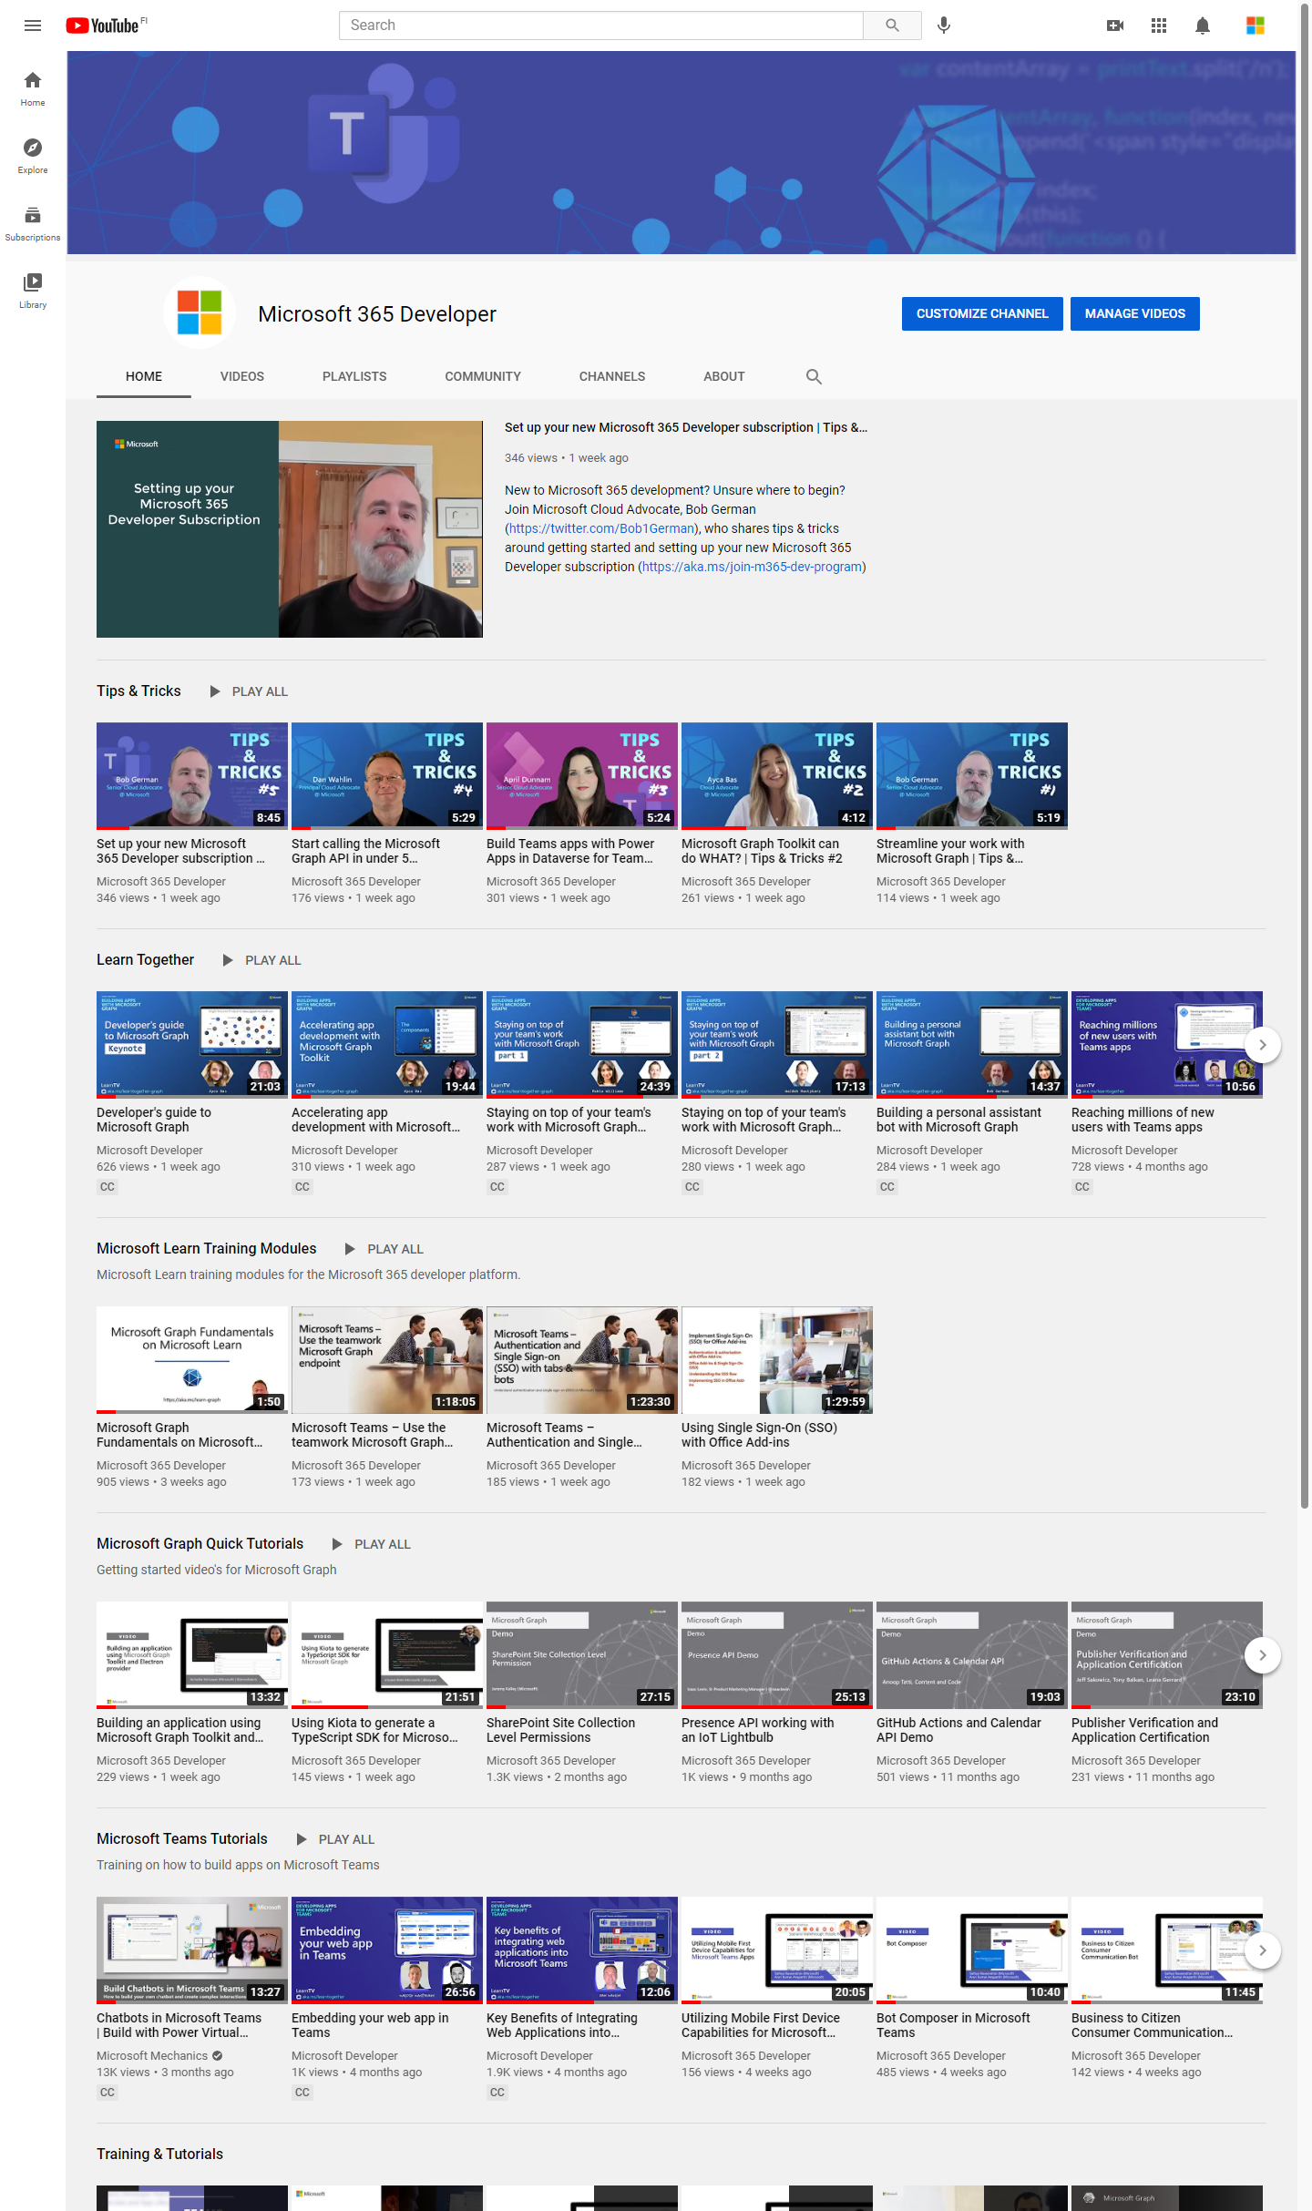
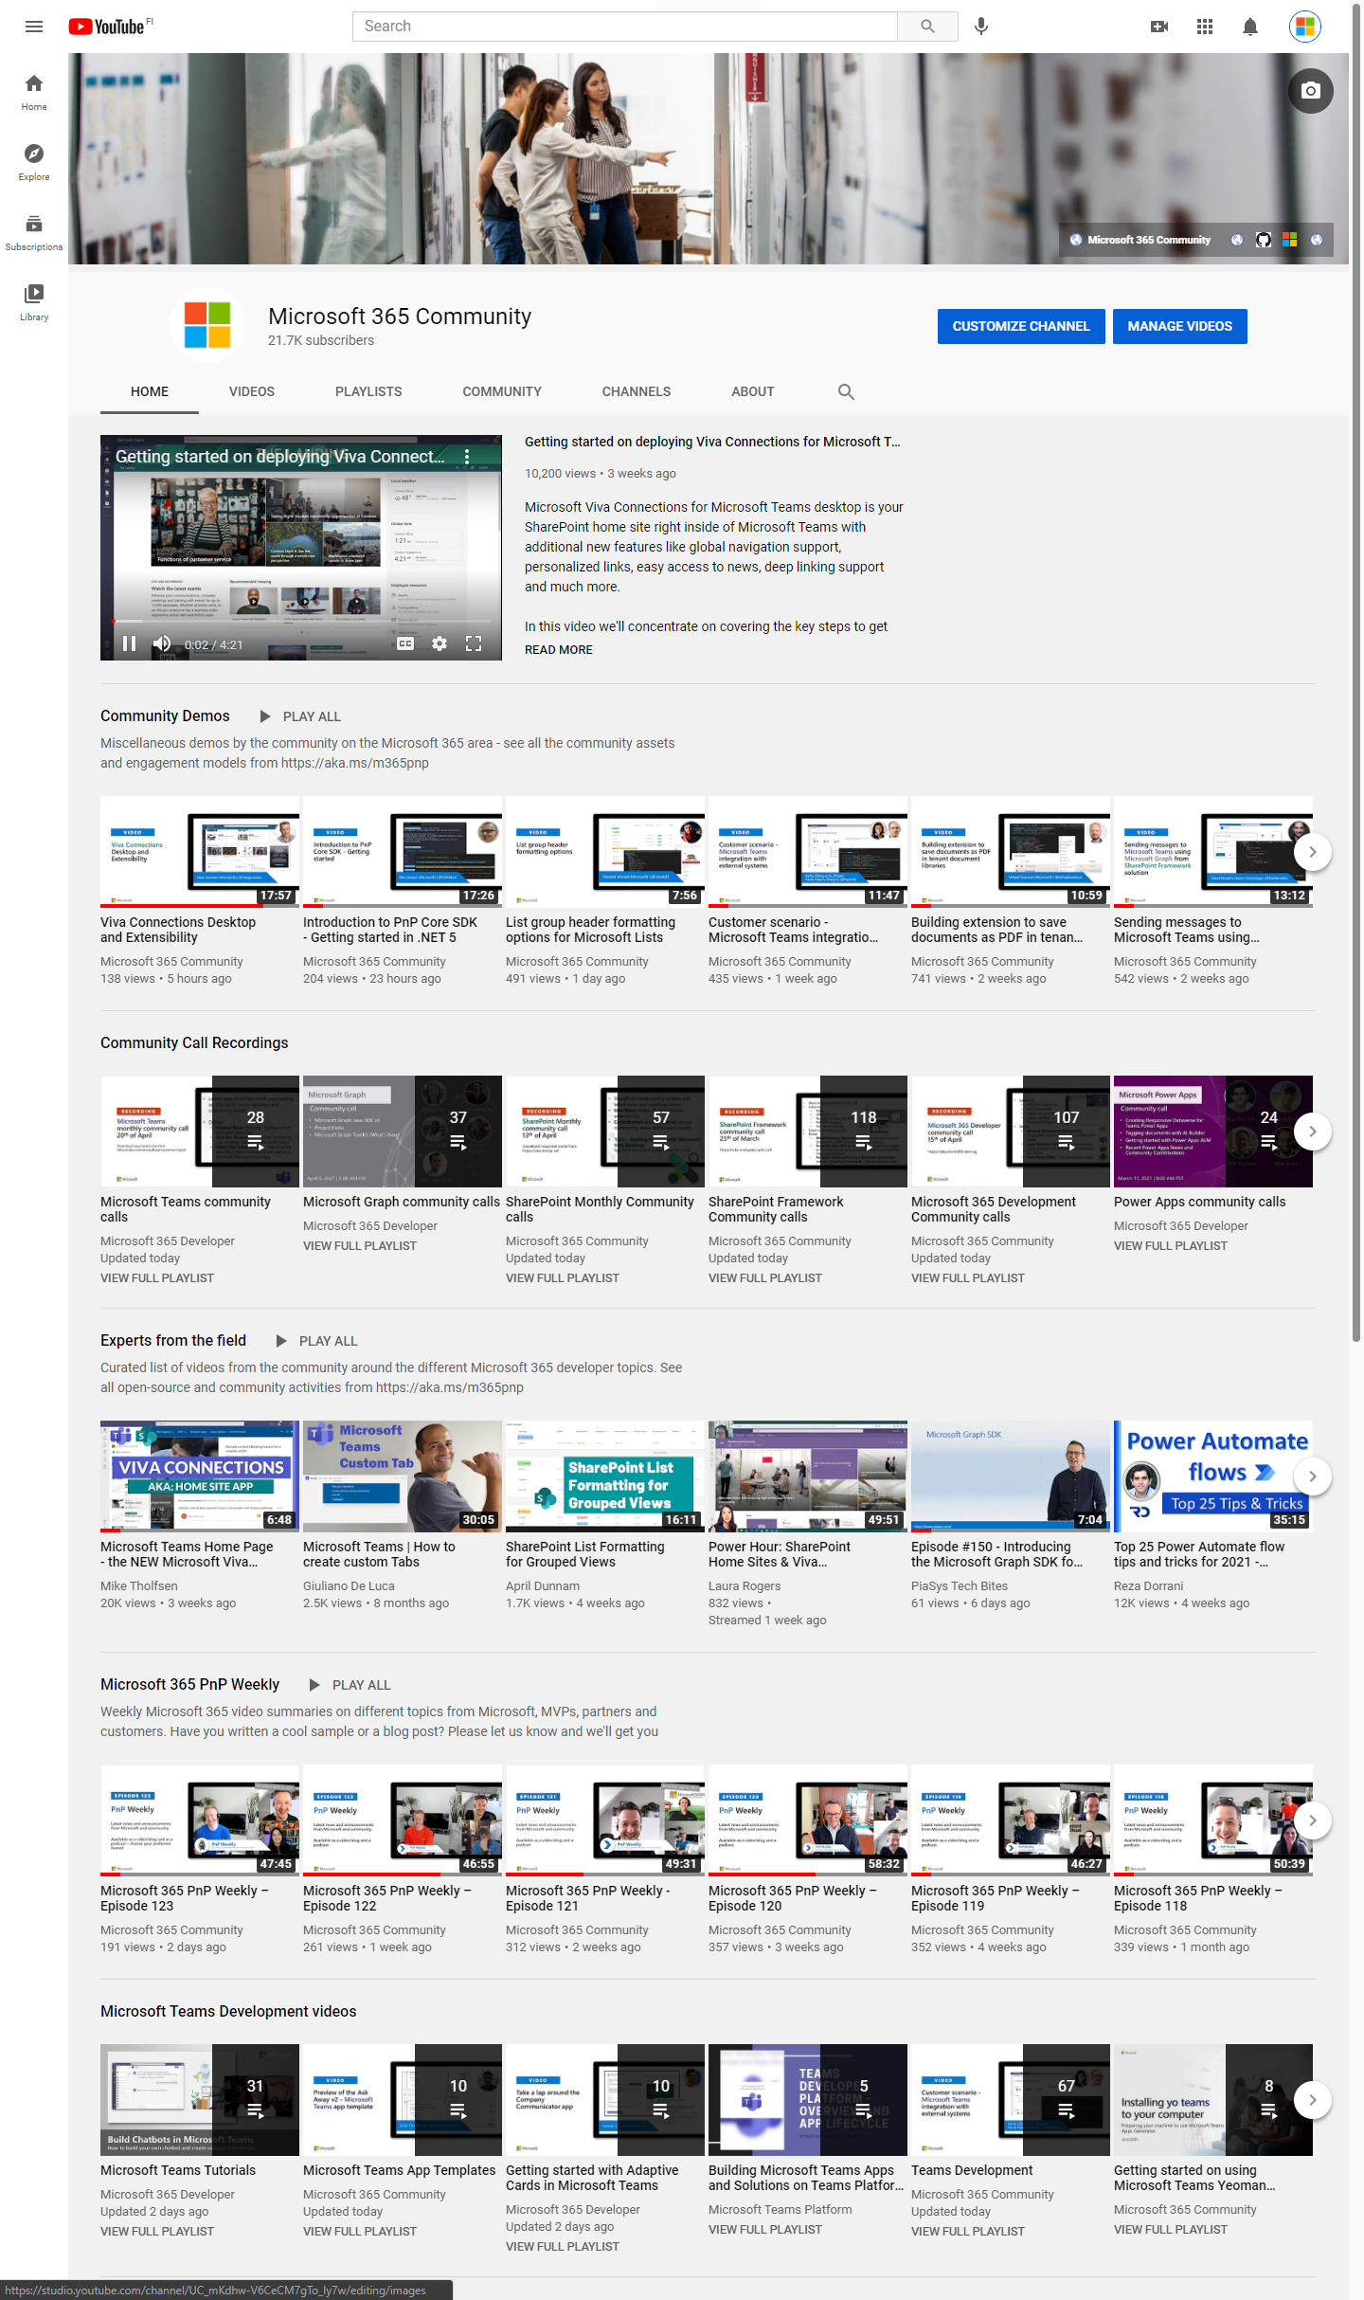
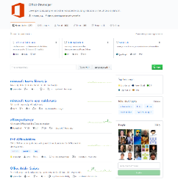
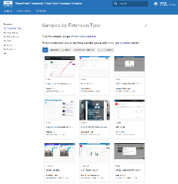
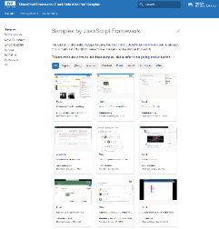
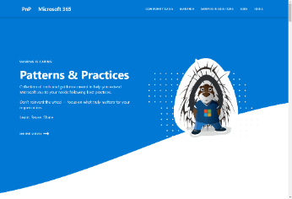
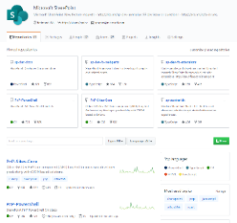
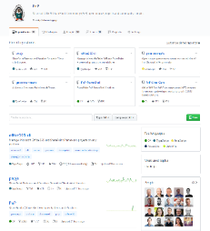
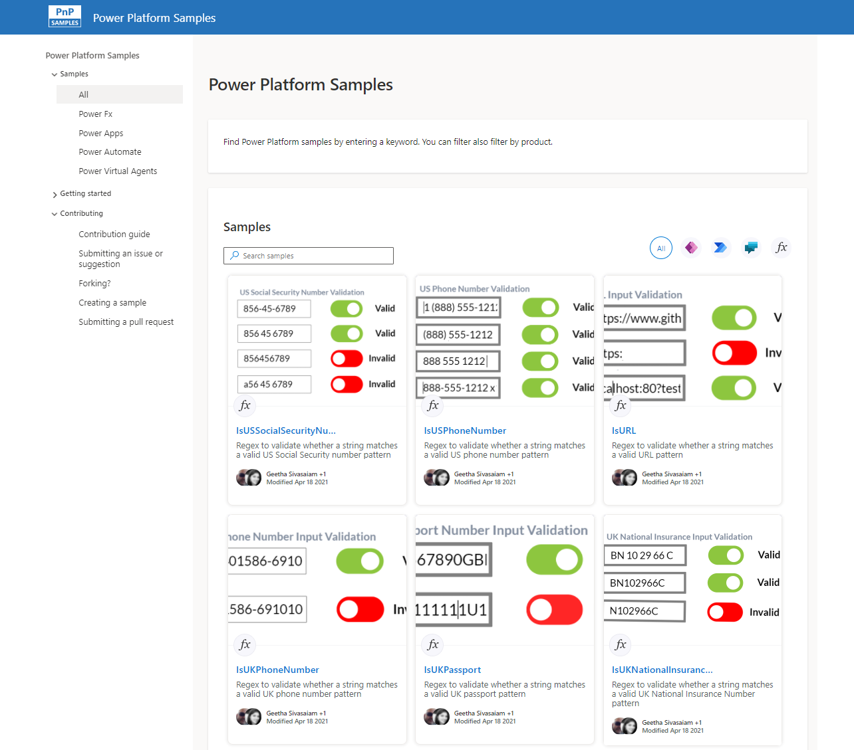
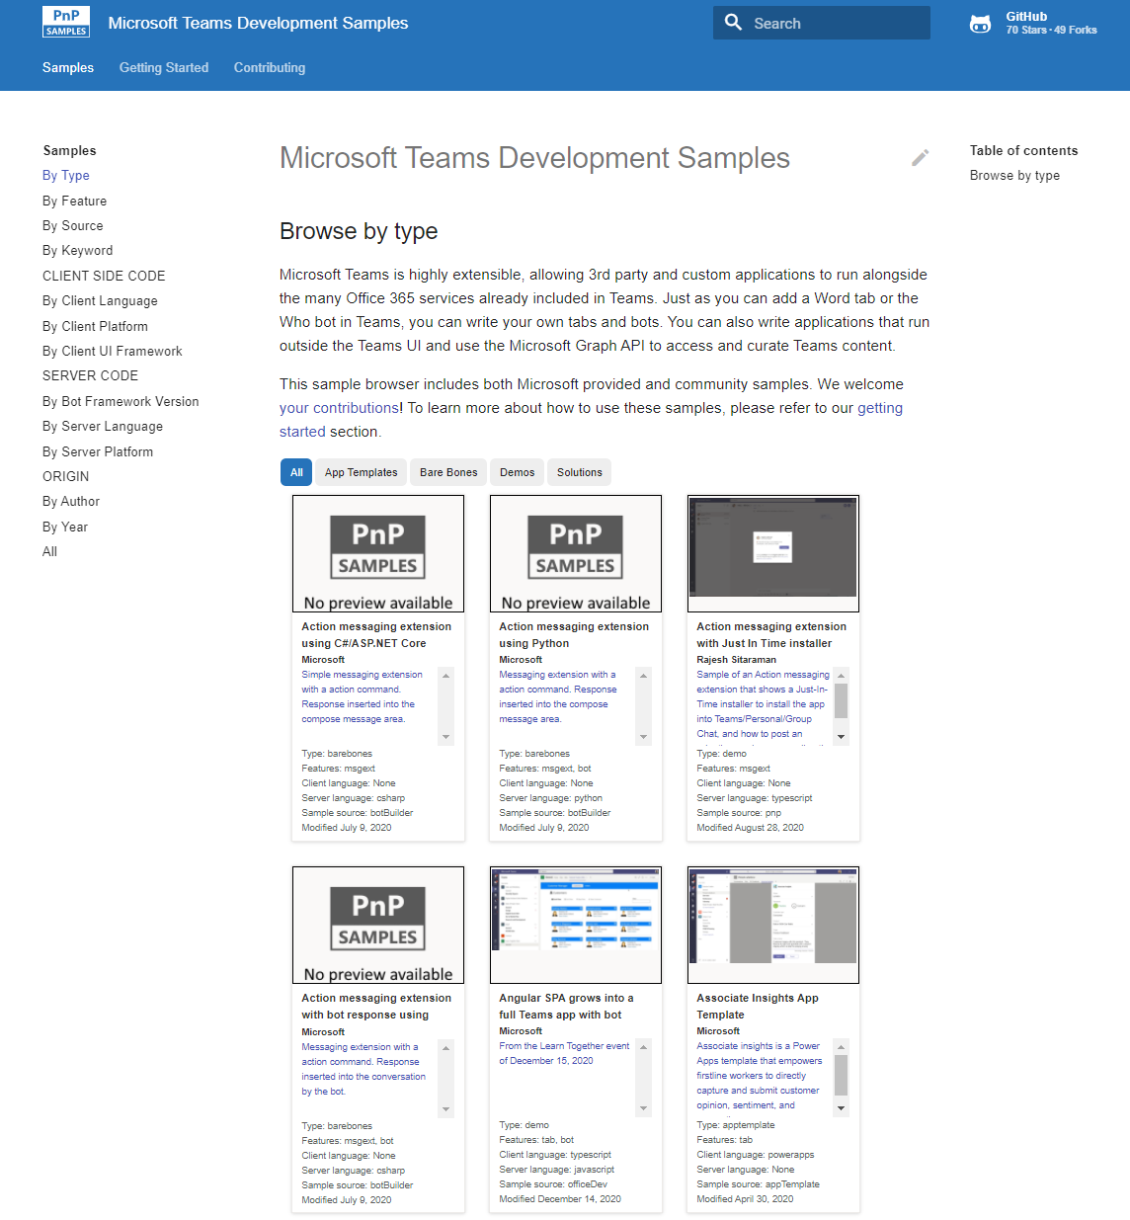
Microsoft 365 developer videos
Microsoft 365 community videos
Open-source
Sample galleries
Open-source initiatives and samples
aka.ms/m365devyoutube
aka.ms/m365/videos
github.com/pnp
github.com/officedev
github.com/sharepoint
github.com/microsoftgraph
aka.ms/m365/samples
aka.ms/teams-samples
aka.ms/spfx-webparts
aka.ms/powerplatform-samples
aka.ms/spfx-extensions
aka.ms/list-formatting
aka.ms/m365pnp
@Microsoft365Dev | @m365pnp

Slide 4
Microsoft 365 developer community calls
Microsoft 365 platform call (weekly) https://aka.ms/m365-dev-call
Adaptive Cards (monthly) https://aka.ms/adaptivecardscommunitycall
Microsoft identity platform (monthly) https://aka.ms/IDDevCommunityCalendar
Office Add-ins (monthly) https://aka.ms/officeaddinscommunitycall
PowerApps (monthly) https://aka.ms/PowerAppsMonthlyCall
Microsoft 365 Community (bi-weekly) https://aka.ms/m365-dev-sig
Viva Connections and SPFx (bi-weekly) https://aka.ms/spdev-spfx-call
All calls and assets: https://aka.ms/m365pnp
Notes:
m365-dev-sig

Slide 5
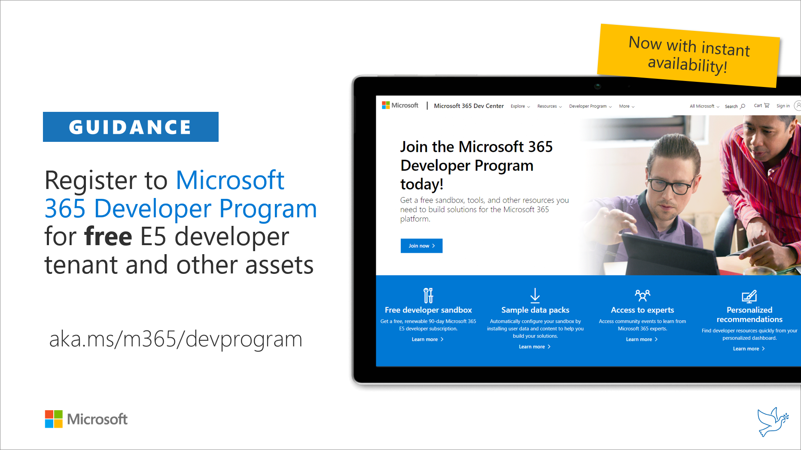
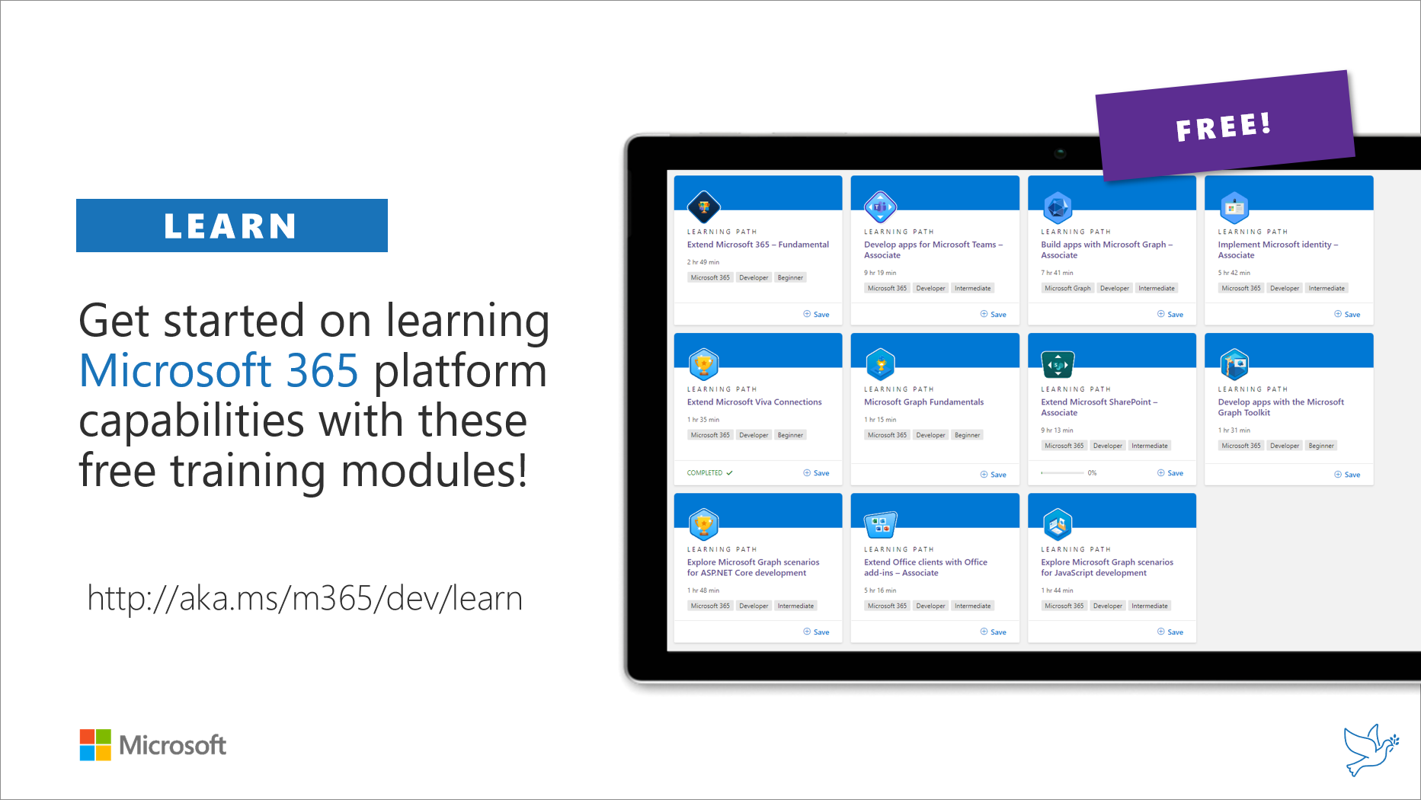
Getting started assets for Microsoft 365 dev
aka.ms/m365/devprogram
aka.ms/m365/dev/learn

Slide 6
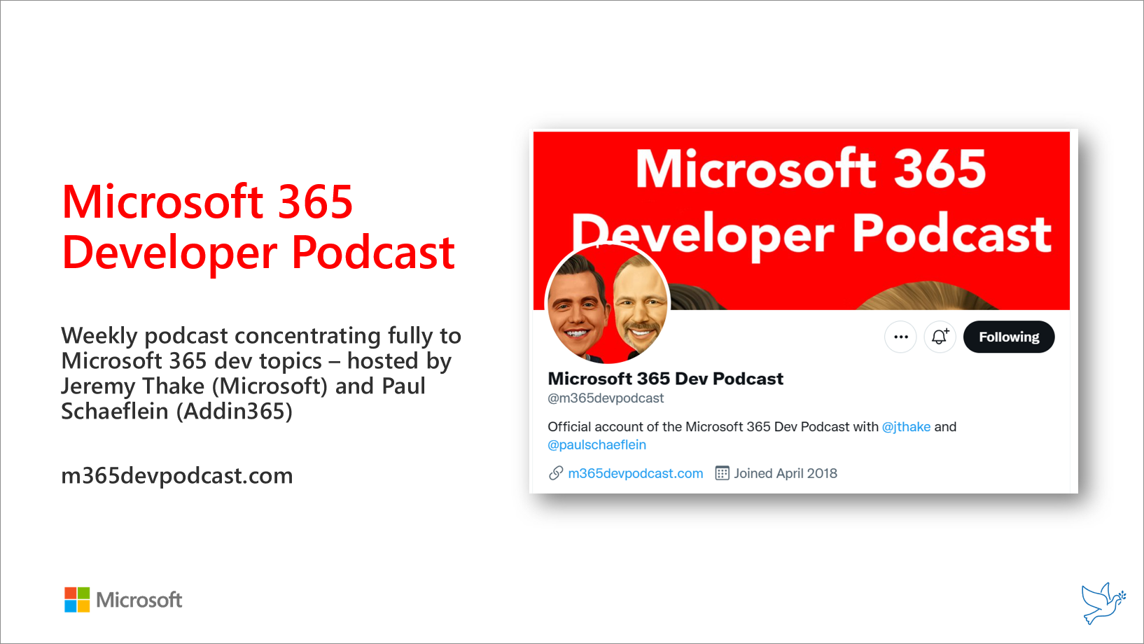
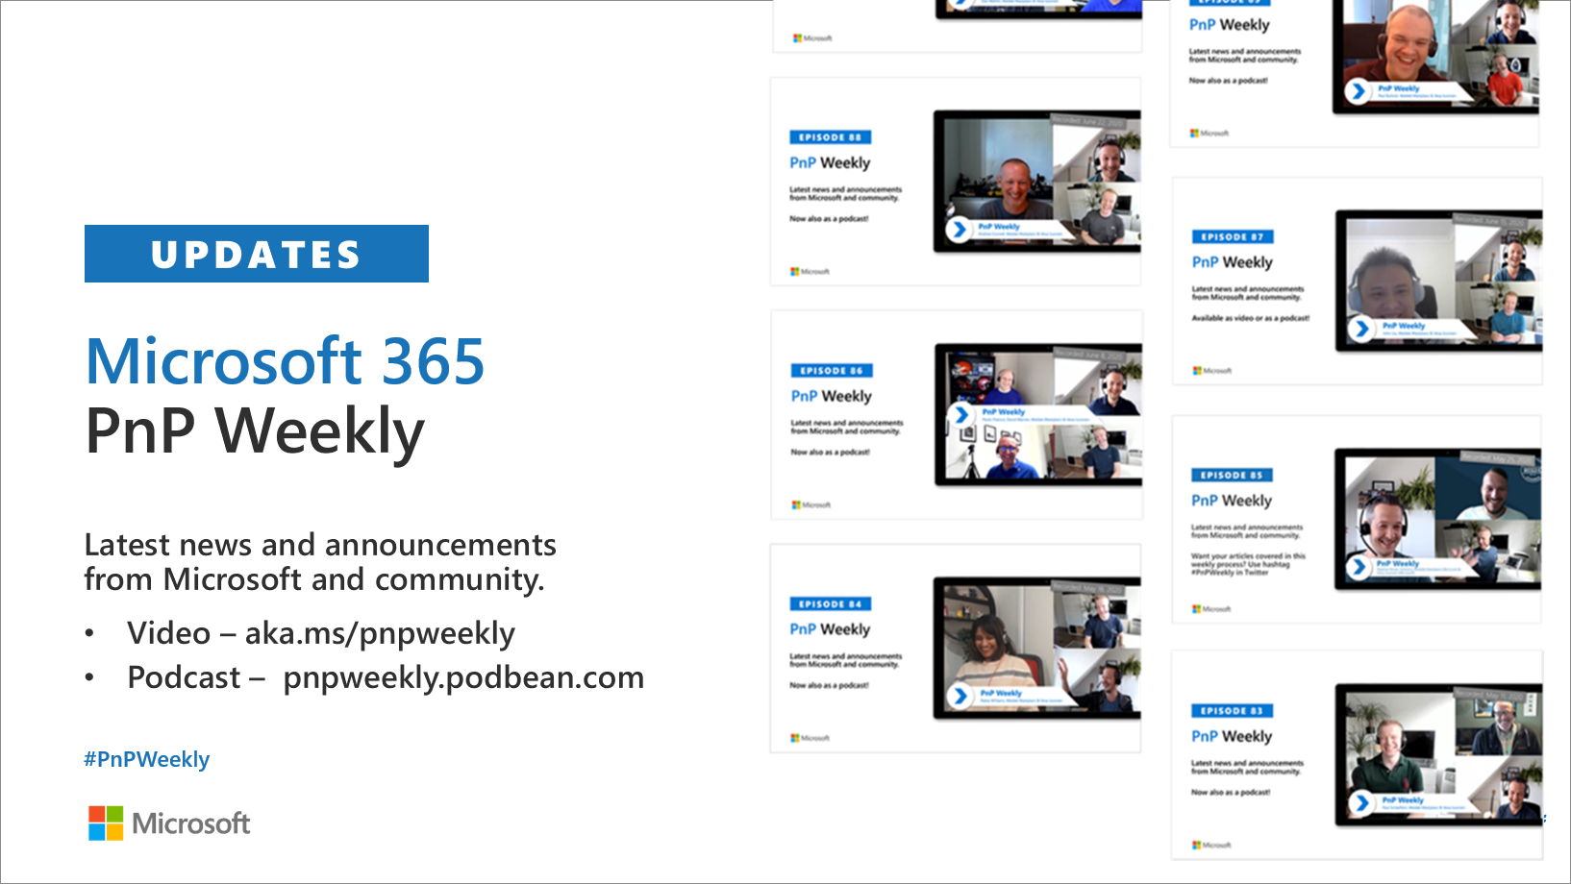
Microsoft 365 Developer podcasts
m365devpodcast.com
Video – aka.ms/pnpweekly
Podcast – pnpweekly.podbean.com

Slide 7

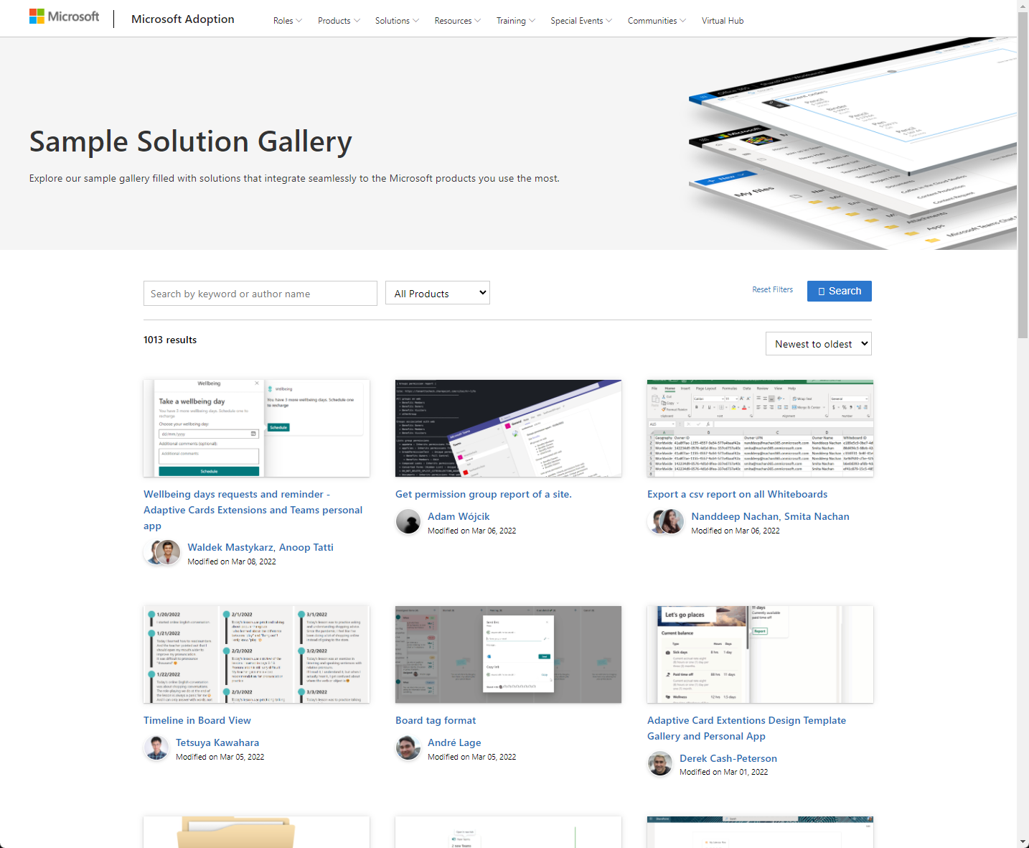
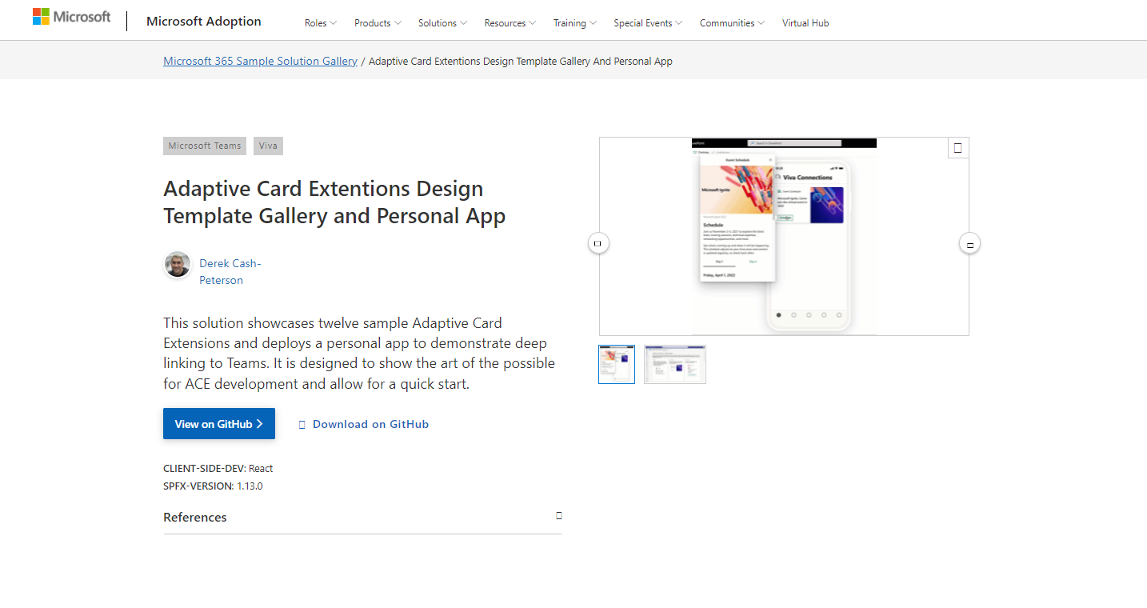
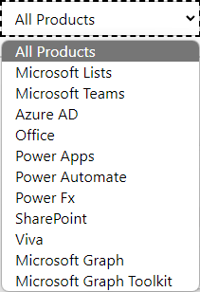

SAMPLES
New Microsoft 365 sample gallery with more than 500 samples from Microsoft and community
1060
aka.ms/m365/samples

Slide 8
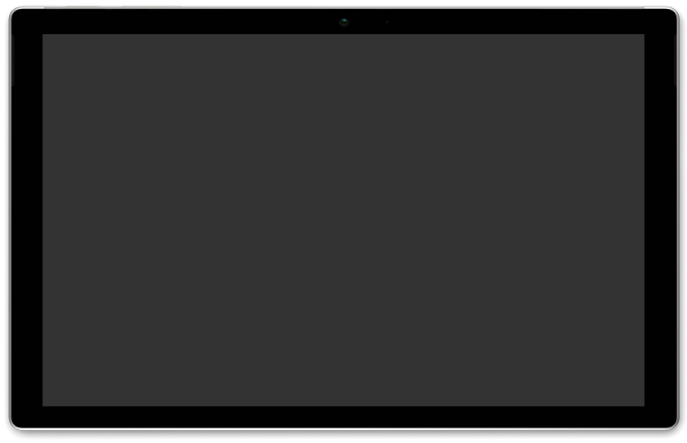
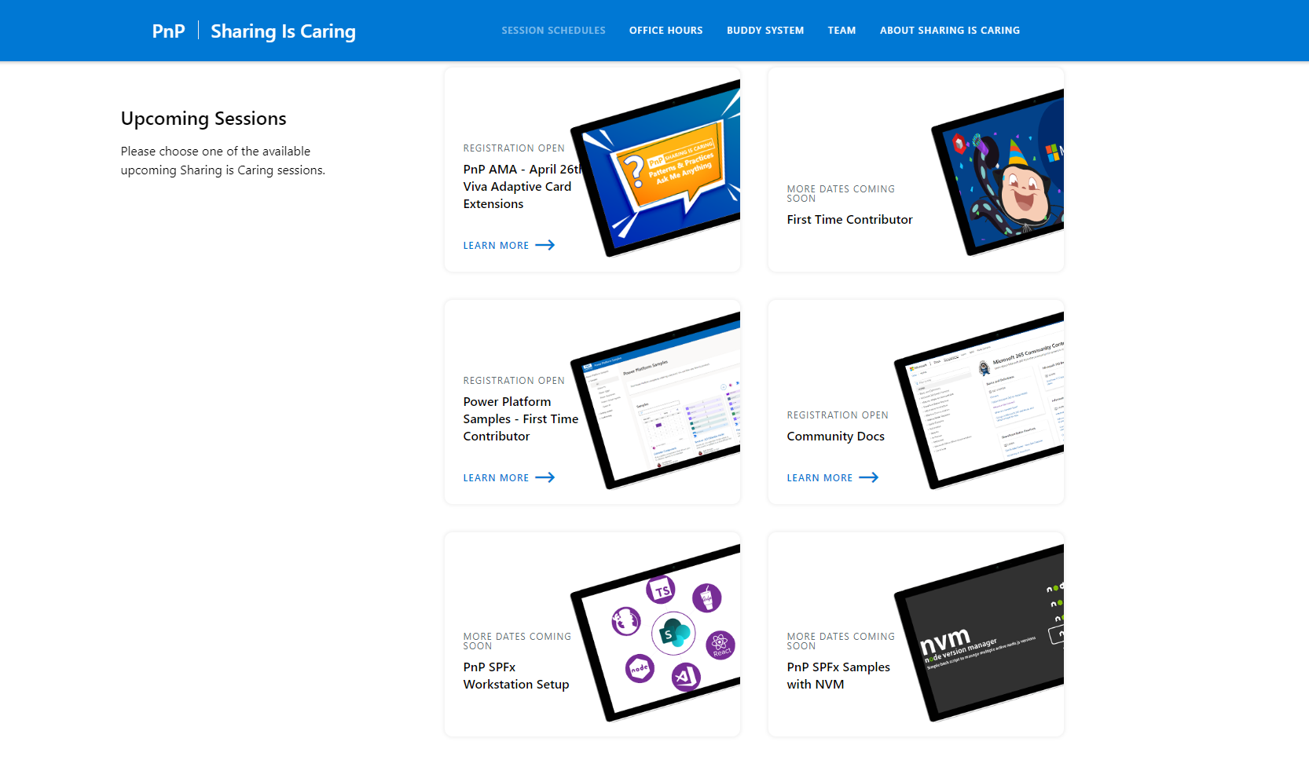
GUIDANCE
Learn how to get started in the open-source PnP community!
Upcoming Sessions:
General First Time Contributor
Power Platform Samples – First Time Contributor
Community Docs
SPFx Developer Workstation Setup
Using PnP SPFx samples w/ NVM
More than code with VS Code
First-time presenter
M365 Maturity Model Practitioners
Ask me anything (Viva Connections - April 26th)
TODAY!
https://aka.ms/sharing-is-caring
Notes:
25 Total attendees, 16 attendees who attended both First-Time Contributors and Community Docs sessions.

Slide 9

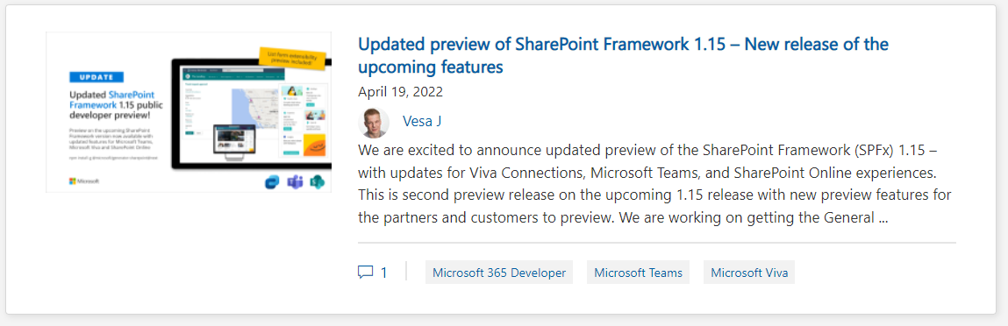
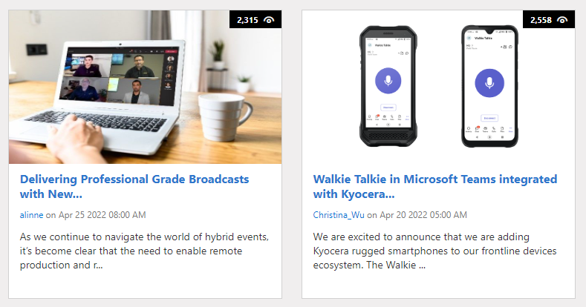
https://aka.ms/m365dev/blog
https://aka.ms/teams/blog
https://aka.ms/microsoftviva/blog
Notes:
New pull as needed sync model for content types along with APIs
Recap news and announcements from Enterprise Connect including Teams Rooms, RSVP options for hybrid meetings, and more
Follow up to initial customer story with Atlassian to dive deeper into Teams app
Tips and tricks for using Power Automate to track and collaborate on tasks

Slide 10



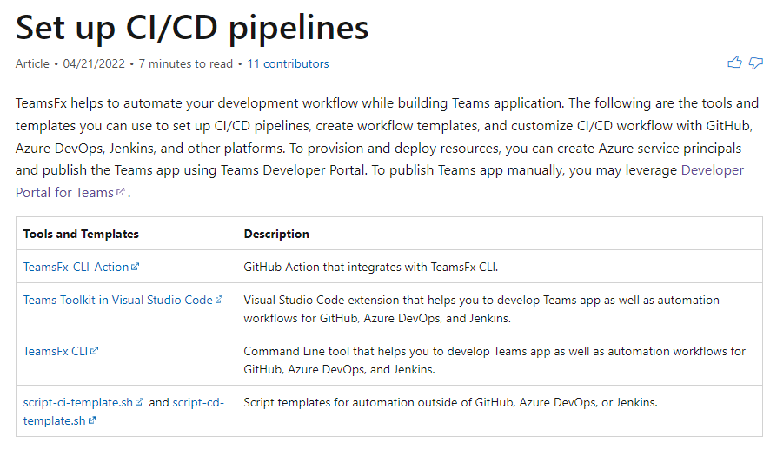
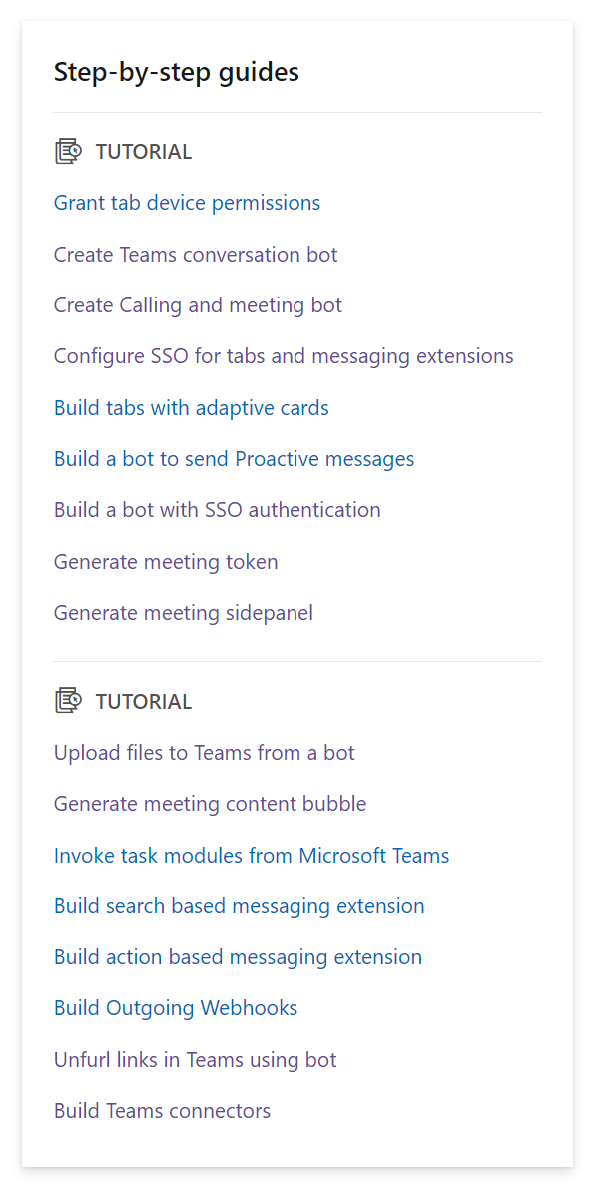






Teams Platform updates Feature updates
Doc updates Step-by-step guides
Linear topics
1
Task oriented approach
Linear topics
End to end scenario
Docs: http://aka.ms/TeamsDevDocs > Microsoft Teams Developer Documentation > Step-by-step guides
Docs: http://aka.ms/TeamsDevDocs > Tools and SDKs > Teams Toolkit for Visual Studio Code > Create a Set up CI/CD pipelines sidepanel
@Microsoft365Dev
aka.ms/TeamsPlatformUpdates
aka.ms/TeamsDevDocs
aka.ms/TeamsSamples
aka.ms/TeamsPlatformFeedback
Notes:
Hello everyone. I’d walk you through the platform and documentation updates. Let’s start with the platform update on the left side.
1. We’ve recently released documentation on CI/CD pipelines. TeamsFx helps to automate your development workflow while building Teams application. Using tools and templates you can set up CI/CD pipelines, create workflow templates, and customize CI/CD workflow with GitHub, Azure DevOps, Jenkins, and other platforms. To provision and deploy resources, you can create Azure service principals and publish the Teams app using Teams Developer Portal.
You can find the documentation link here.
Now let’s move to the doc updates on the right
2. We’ve been working on multiple step-by-step guides. Step-by-step guide is an artifact that has a task-oriented approach, linear topic, provides an end-to-end scenario, and loops you back to the documentation. Here is a list of all the sbs guides we’ve worked on so far. If you have any suggestions or would like us to build some new ones then please do let us know.
So, these were the platform updates, if you have any feedback or suggestion, please post on aka.ms/TeamsPlatformFeedback- the link is available in the footer. You could also follow us on twitter and configure to the RSS feeds to get regular platform updates.

Slide 11
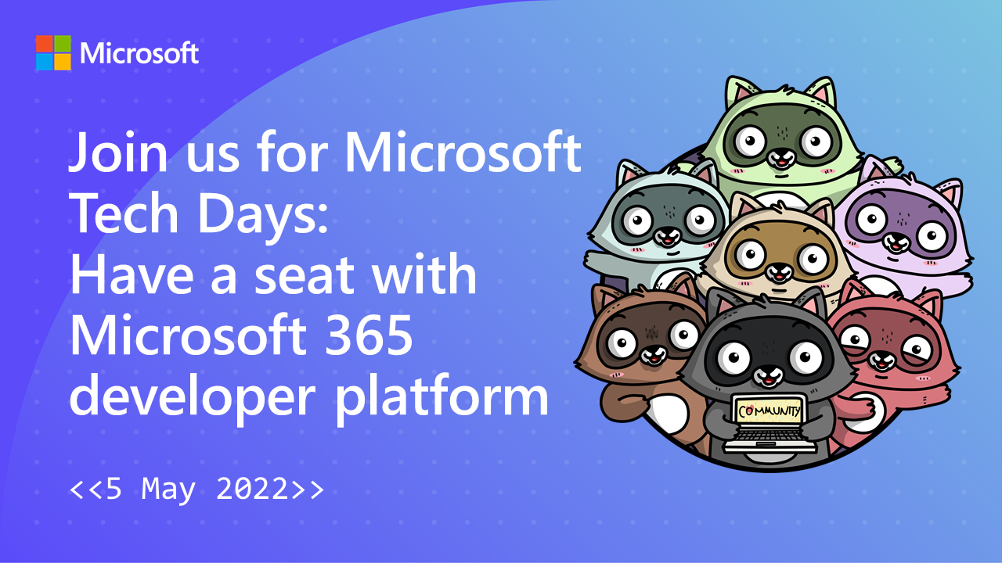
https://aka.ms/techdays/m365
Notes:
hosts Microsoft Cloud Developer Advocate Waldek Mastykarz and Principal Product Manager Vesa Juvonen
Rick van Rousselt and Thomy Gölles.
Stephan Bisser.
Paolo Pialorsi.
Albert-Jan Schot.

Slide 12

EVENT
Microsoft Build
May 24-26
Registration coming soon:
https://mybuild.microsoft.com

Slide 13

Survey – help shape the future of search!
This 5-minute survey is intended for users of GitHub and other source control platforms, to better understand their search habits and their need for alternate search solutions.
Do you have opinions about Git search? Complete the survey here:
aka.ms/GitHubSearchSurvey

Slide 14


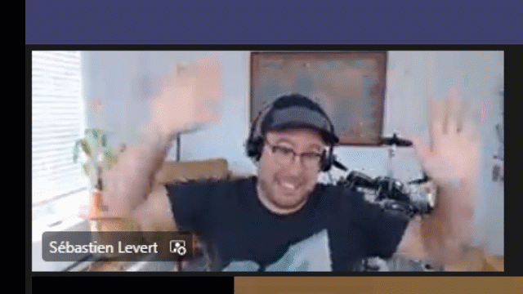
Optional picture time!
Video on and we’ll grab a Together Mode pic with those who are willing to do this.
We are together on this as a community!
Let’s all be like Seb
By enabling your camera for the picture, you grant us permission to share your picture in social media.

Slide 15

DEMO
Saurabh Bhatia - Create an apps that extends across Teams, Outlook, and Office
Waldek Mastykarz, Alex Terentiev - Easily fix errors in your SPFx projects with CLI for Microsoft 365

Slide 16
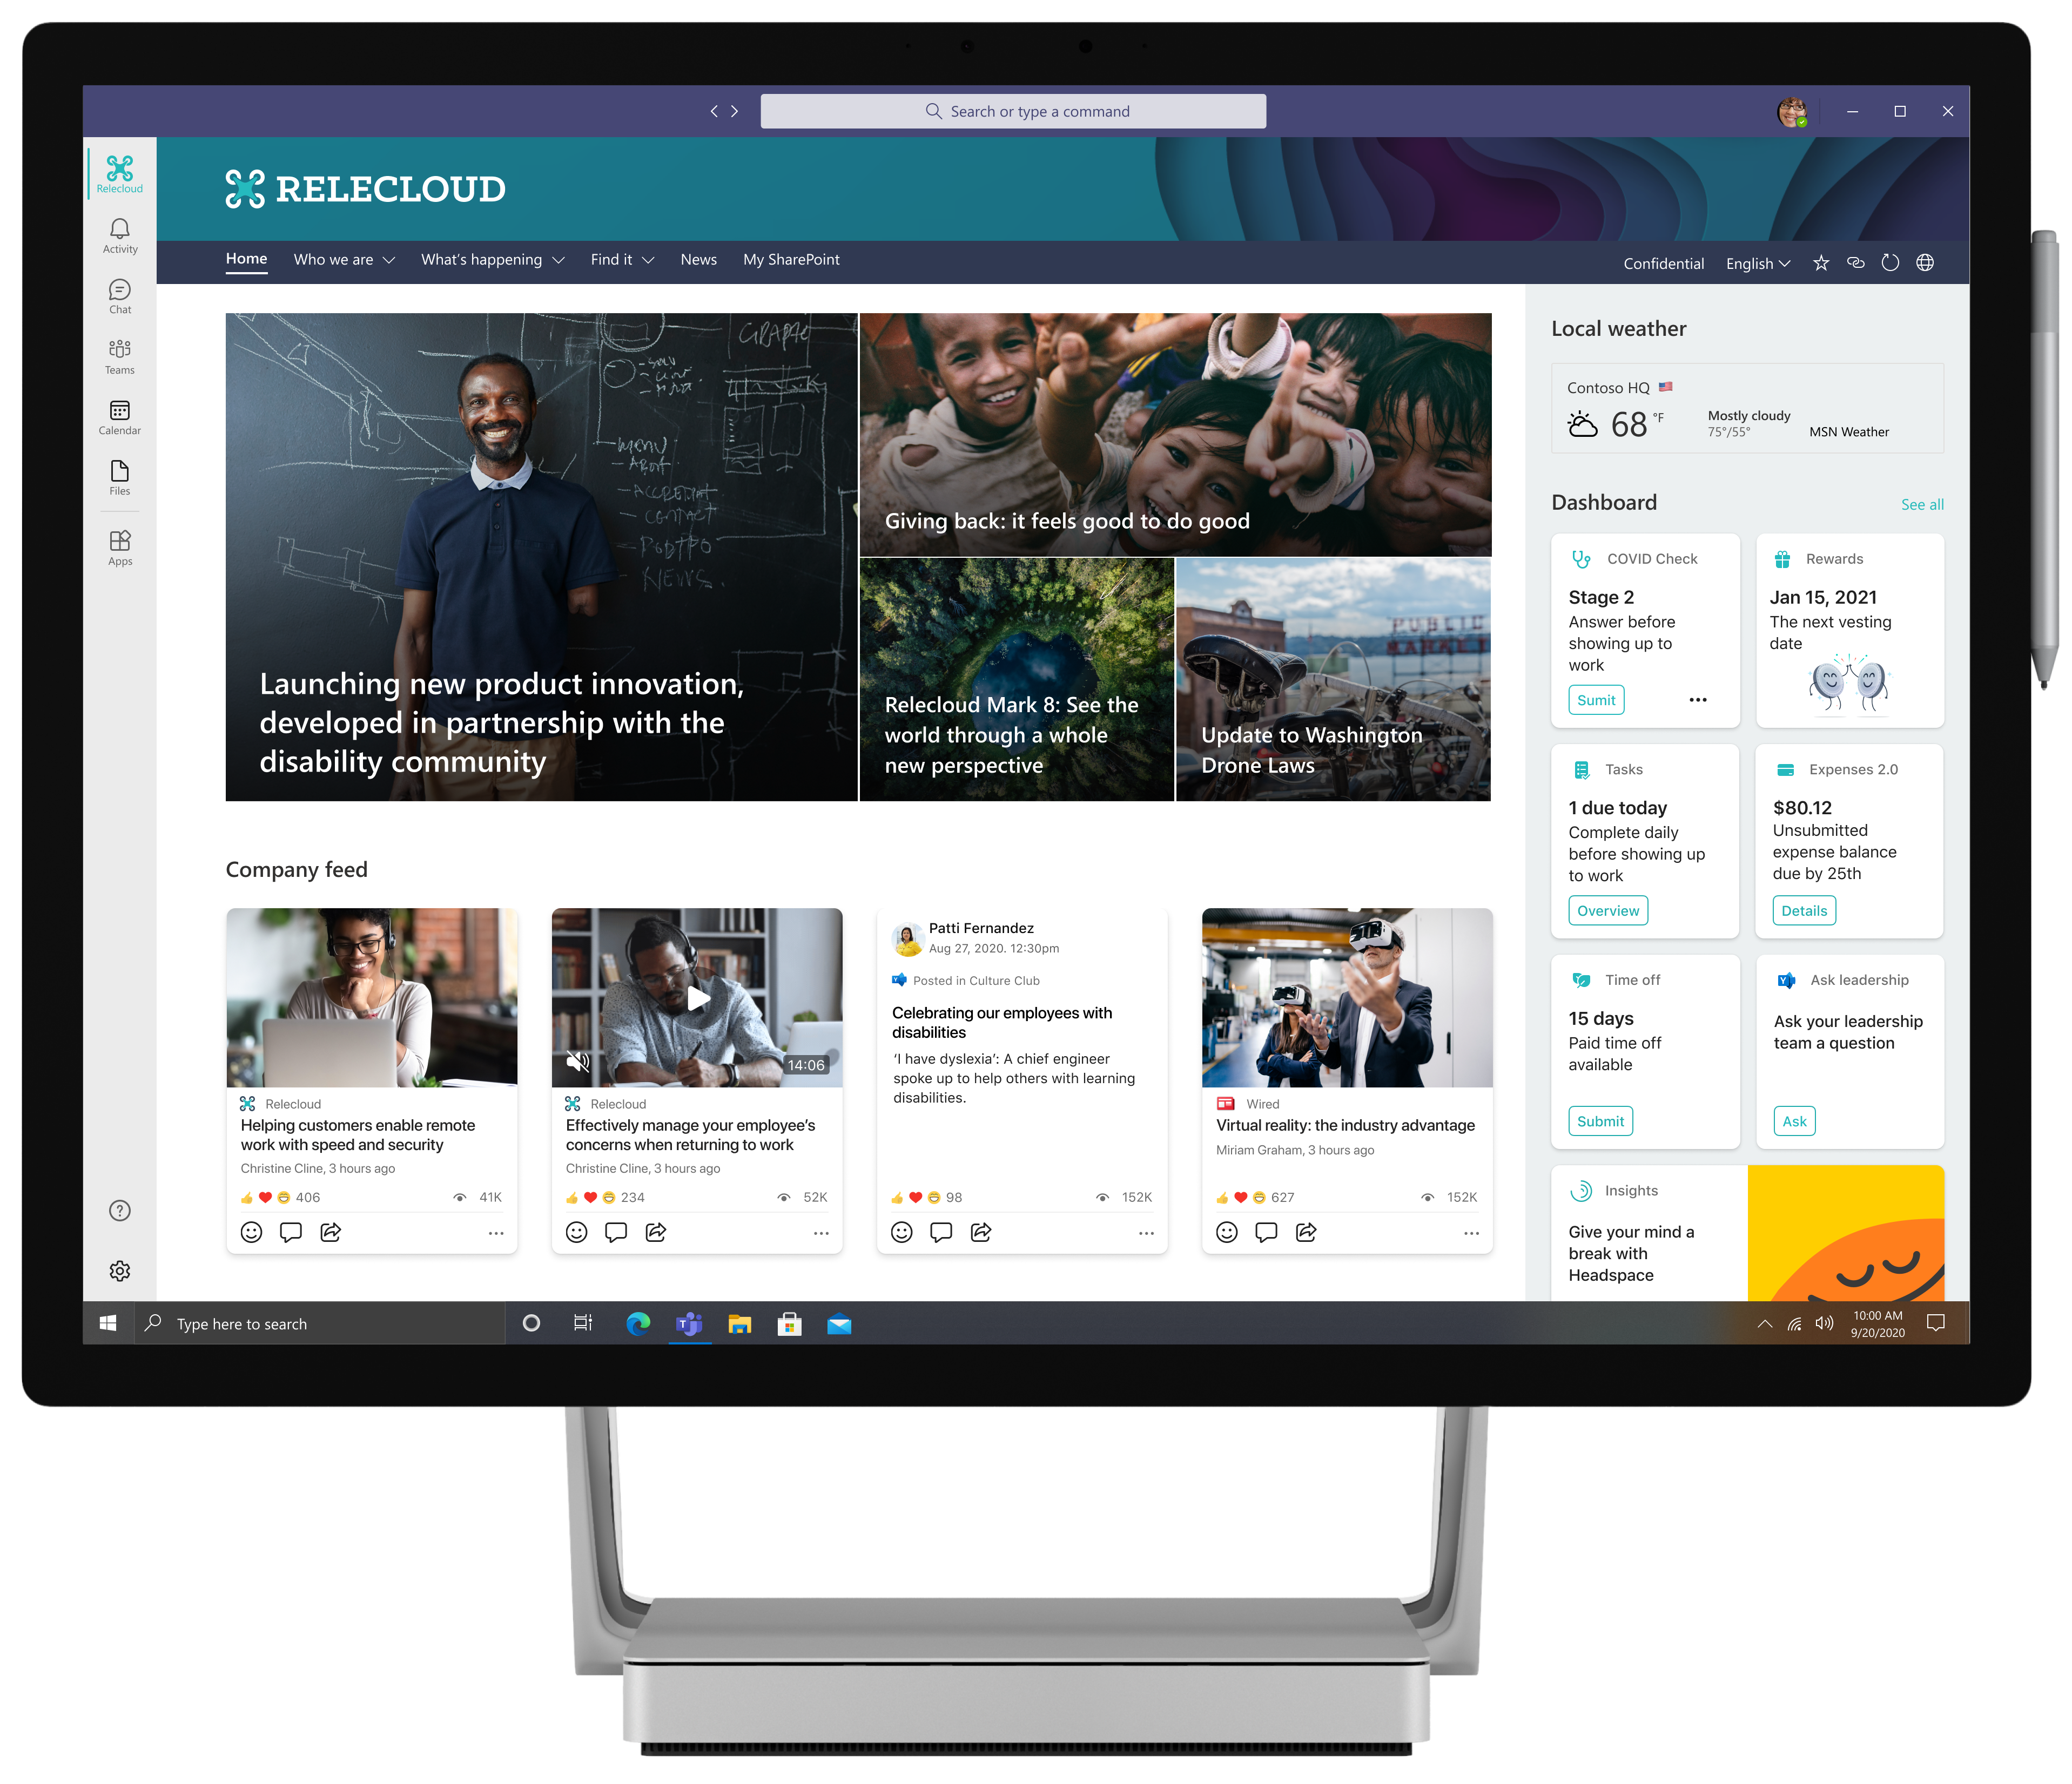
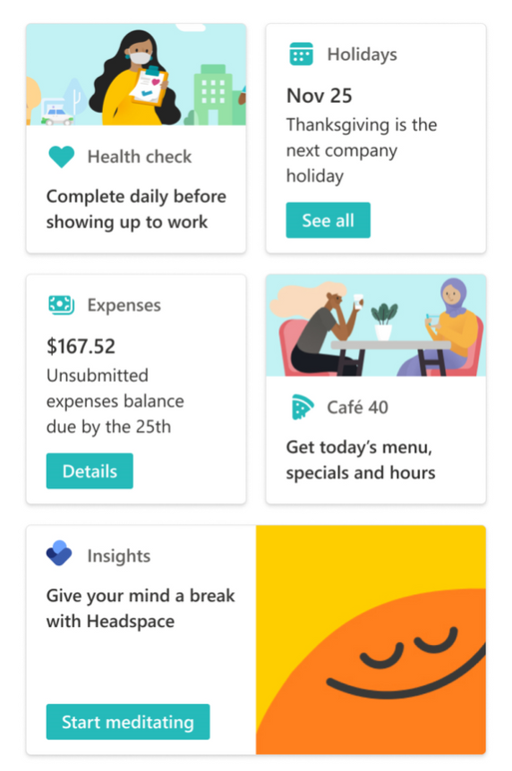
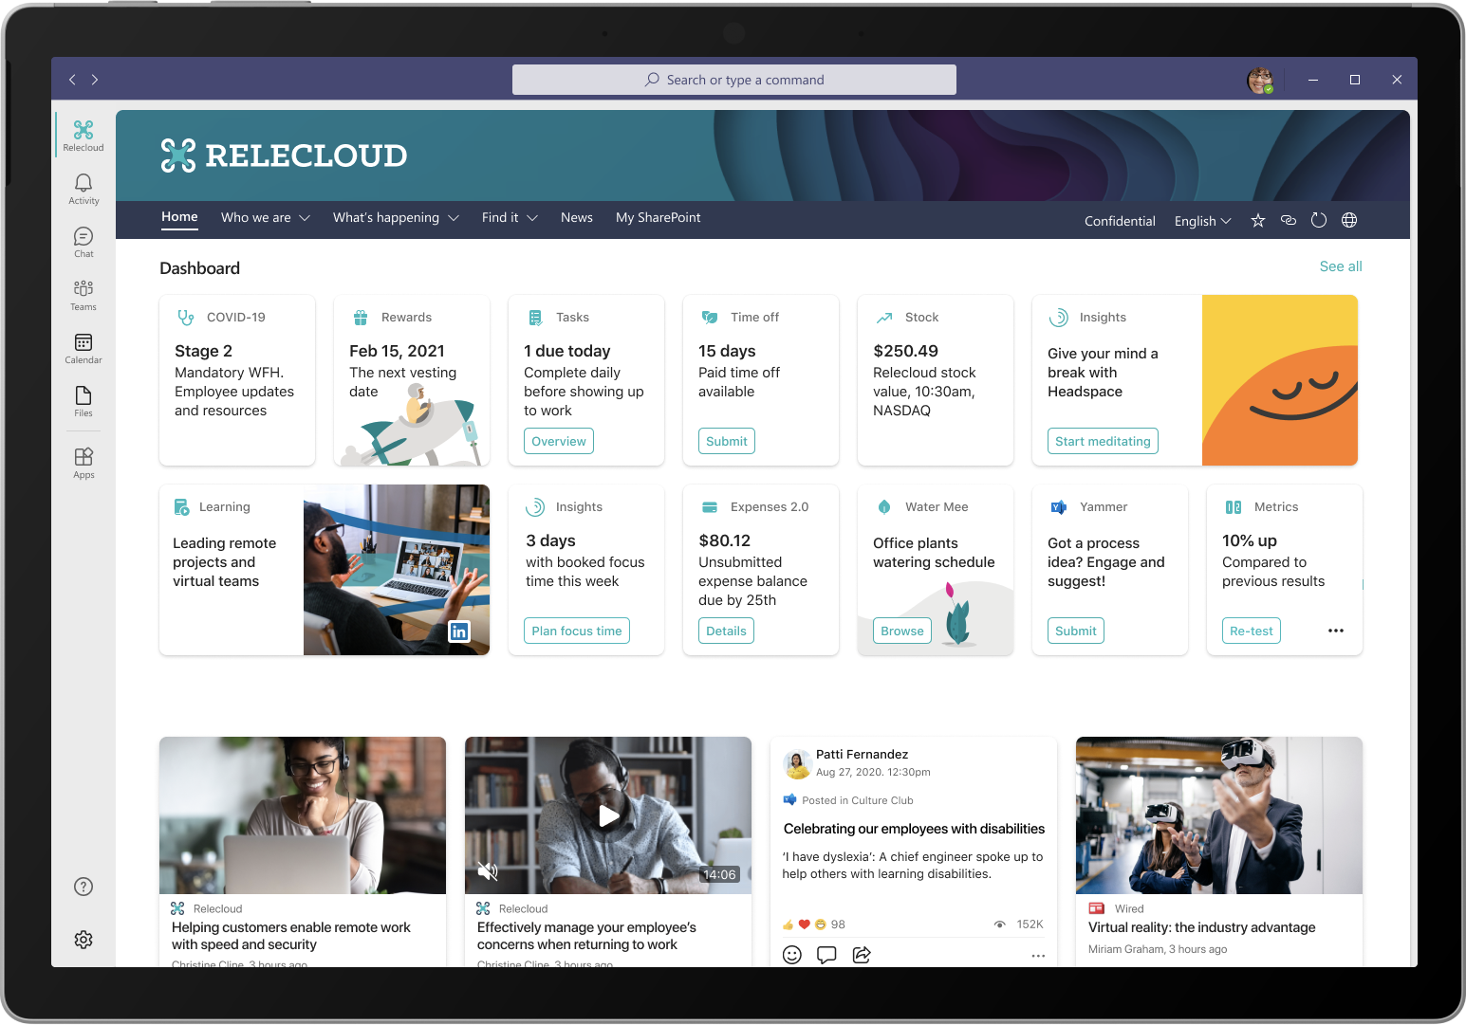

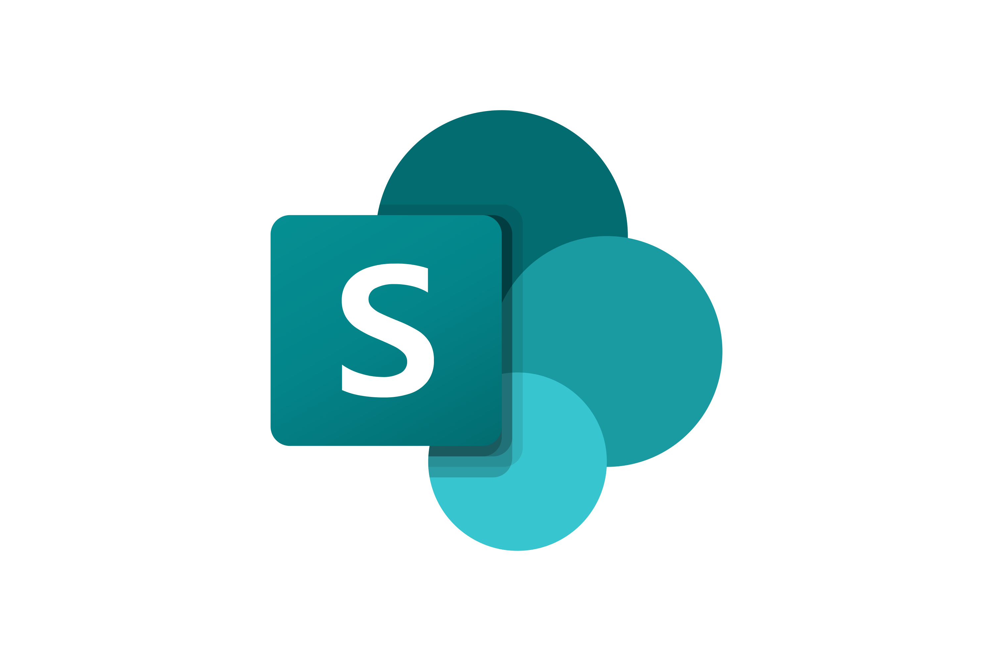



26th of April 9 AM PT
AMA
Got questions on Viva Connections development? Don’t miss out this event!
Ask-Me-Anything (AMA) event with Microsoft Viva Connections platform engineering team on 26th of April 9 AM PT
Register today! https://aka.ms/viva-ama-april-2022
Notes:
Dan’s slide

Slide 17
Thank you
Recording will be available in 24 hours on
Microsoft 365 Community (PnP) YouTube channel
https://aka.ms/M365PnP/videos
(subscribe today)
Follow us on Twitter
@Microsoft365Dev | @M365PnP
Next Microsoft 365 Platform call: May 3rd at 08:00 am PT
All available community calls from https://aka.ms/m365pnp

Slide 18



aka.ms/m365pnp

